Slide 1
Software Development Lifecycle (SDLC)
Presenter : md wahidul islam
Student id: 20197va

Slide 2
What is SDLC?
SDLC (Software Development Life Cycle) defines all the standard phases which are involved during the software development process. SDLC is a process of developing software through a phased manner in the following order
Requirements Gathering/Planning
Design the software
Development
Test
Implementation
Maintenance.
Each stage has a definite entry and exit criteria along with deliverables.

Slide 3
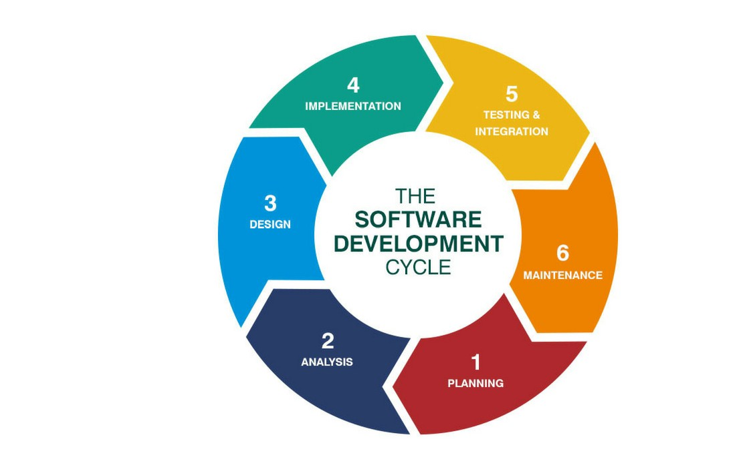
Software Development Life Cycle (SDLC) phases

Slide 4

Phases of SDLC (in detail)

Slide 5
Requirement Gathering & Analysis
Requirement Gathering and Analysis
Requirements describe the features of the system we are going to design, develop etc. This is a most crucial phase in the software development lifecycle. Business Analyst will collect basic requirements from the clients like what does the software do, who are target customers etc. Based on that, BA will accept or decline the project. If the project is acceptable, BA will focus on what should be achieved and how to achieve it.
After gathering the requirements, BA will prepare requirements document by adding all the customer needs. The requirements document should be shared with customers and it should be accepted by the customer. After getting approval from the customer, BA will give an overview for the team(team leads, designer, developers) to accomplish end user requirement. All requirements need to be documented perfectly. So, it will be easy for the whole team to understand the client expectations.

Slide 6
Design Phase
Design
In this phase, system architect and team leaders will discuss software & hardware requirements for the overall system architecture based on the FRS(Functional Requirement Specification). System architect will prepare 2 types of document. One is the High-Level document and another one is the Low-Level document.
In the High-Level document, we will get an overview of what are the modules in the entire system, how we are going to implement each module, link between each module etc. In the Low-Level document, we will design flowcharts, blueprints, in which programming language we are going to implement this application, databases etc.

Slide 7
Development Phase
Development
Only developers will involve in this phase and they will do programmatic part here. This is the longest phase of the SDLC. Developers will divide each module into different tasks and then will start coding/implementing each task. After completion of coding part, developers will do unit testing to find the logical errors in the initial stage.
At the time of unit testing, if developers find any major issue or enhancements regarding requirements, they will report to requirements team for further process. After completion of this phase, the system will move to the testing phase.

Slide 8
Testing Phase
Testing
Testers will test all the modules developed in the previous phase as a complete system. The QA (quality assurance) will do different kinds of test approaches to certify the application. Testing types are functional testing, system testing, regression, load testing, performance testing, UAT (user acceptance testing) etc.
QA team will write test cases for each module with the positive and negative scenarios. If they find any bugs at the time of testing, again the development process will take place.

Slide 9
Deployment
Deployment
After fixing all the defects, the software will handover to the customer. In this phase, UAT (User Acceptance Testing) will take place. And we should prepare a user document in this phase. The software will be delivered to the limited number of users only for Beta testing.

Slide 10
Maintenance
Maintenance
Once the software is deployed, it should be under maintenance for few days. Because in the user environment we may get errors at the time of functioning. We have to fix those issues to work the software in a smooth manner. And customers may add request any enhancements to improve the software as per the user requirements. If they add any enhancements, again we will do all the process.

Slide 11
Why use SDLC?
Here, are some prime reasons for using SDLC method:
It aims to produce a high-quality software system which helps you to meet the customer expectations
A formal review is created after completion of every stage that provides optimum management control.
SDLC helps you to create considerable system documentation
It produces many intermediate products which can be reviewed to verify whether they can meet the user's needs and are according to the stated requirement.
SDLC helps you to ensures that system requirements can be traced back to stated business requirements
Every phase has a specific deliverable, entry and exit criteria
Development stages go one by one which is an ideal option for the small or mid-sized projects where requirements are clear

Slide 12
Features of SDLC
Features of SDLC
The model structure & functions are well documented, and the tested result is readily available
The project can be completed step by step before another project begins.
Project units are distinct and easily identifiable.
Risk management is integral to the model and is handled efficiently.
The project can be designed so that the pieces should be sourced

Slide 13
Software Testing Life Cycle (STLC)

Slide 14
What is STLC?
Software Testing Life Cycle (STLC) is the testing process that is executed in a well-planned manner. In the STLC process, various activities are carried out to improve the quality of the product. However, STLC phases only deal with testing and detecting errors but not development itself.
Different companies define different phases in STLC. However, generic Software Test Life Cycle has the following stages.
Requirement Analysis
Test Planning
Test Development
Test Environment Setup
Test Execution & Closure
Each of these stages has a definite Entry and Exit criteria, Activities & Deliverables associated with it.

Slide 15
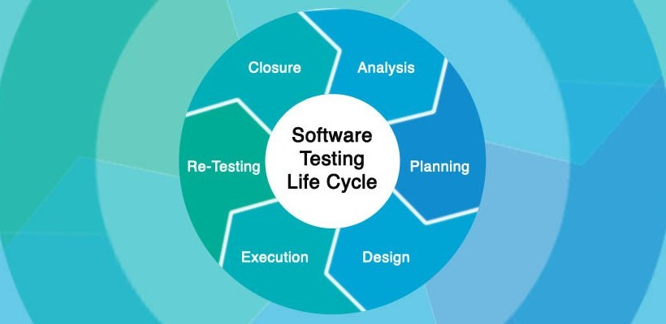
Software Testing Life Cycle –STLC Phases

Slide 16
Phases of STLC (in detail)

Slide 17
Requirement Analysis
During this phase, test team studies the requirements from a testing point of view to identify the testable requirements.
The QA team may interact with various stakeholders (Client, Business Analyst, Technical Leads, System Architects etc.) to understand the requirements in detail.
Requirements could be either Functional (defining what the software must do) or Non-Functional (defining system performance /security availability )
Automation feasibility for the given testing project is also done in this stage.

Slide 18
Requirement Analysis
Activities
Identify types of tests to be performed.
Gather details about testing priorities and focus.
Prepare Requirement Traceability Matrix (RTM).
Identify test environment details where testing is supposed to be carried out.
Automation feasibility analysis (if required).
Deliverables
RTM
Automation feasibility report. (if applicable)

Slide 19
Test Planning
Typically, in this stage, a Senior QA manager will determine effort and cost estimates for the project and would prepare and finalize the Test Plan. In this phase, Test Strategy is also determined.
Activities
Preparation of test plan/strategy document for various types of testing
Test tool selection
Test effort estimation
Resource planning and determining roles and responsibilities.
Training requirement
Deliverables
Test plan/strategy document.
Effort estimation document.

Slide 20
Test Case Development
This phase involves the creation, verification and rework of test cases & test scripts. Test data is identified/created and is reviewed and then reworked as well.
Activities
Create test cases, automation scripts (if applicable)
Review and baseline test cases and scripts
Create test data (If Test Environment is available)
Deliverables
Test cases/scripts
Test data

Slide 21
Test Environment Setup
Test environment decides the software and hardware conditions under which a work product is tested. Test environment set-up is one of the critical aspects of testing process and can be done in parallel with Test Case Development Stage. Test team may not be involved in this activity if the customer/development team provides the test environment in which case the test team is required to do a readiness check (smoke testing) of the given environment.

Slide 22
Test Environment Setup
Activities
Understand the required architecture, environment set-up and prepare hardware and software requirement list for the Test Environment.
Setup test Environment and test data
Perform smoke test on the build
Deliverables
Environment ready with test data set up
Smoke Test Results.

Slide 23
Test Execution
Test Execution
During this phase, the testers will carry out the testing based on the test plans and the test cases prepared. Bugs will be reported back to the development team for correction and retesting will be performed.

Slide 24
Test Execution
Activities
Execute tests as per plan
Document test results, and log defects for failed cases
Map defects to test cases in RTM
Retest the Defect fixes
Track the defects to closure
Deliverables
Completed RTM with the execution status
Test cases updated with results
Defect reports

Slide 25
Test Cycle Closure
Testing team will meet, discuss and analyze testing artifacts to identify strategies that have to be implemented in the future, taking lessons from the current test cycle. The idea is to remove the process bottlenecks for future test cycles and share best practices for any similar projects in the future.

Slide 26
Test Cycle Closure
Activities
Evaluate cycle completion criteria based on Time, Test coverage, Cost, Software, Critical Business Objectives, Quality
Prepare test metrics based on the above parameters.
Document the learning out of the project
Prepare Test closure report
Qualitative and quantitative reporting of quality of the work product to the customer.
Test result analysis to find out the defect distribution by type and severity.
Deliverables
Test Closure report
Test metrics

Slide 27
Why use STLC?
Here, are Important reasons for using STLC method:
STLC helps make the testing process more sophisticated, consistent and effective
You can include milestones and deliverables for each step of the project
Easy to understand and implement even if the model is expanded to various levels
Time constraints are strongly built in project formulation
Each module of the project is tested before the beginning of the another module
The requirement of the specific project is measured against the actual result

Slide 28
Features of STLC
Features of STLC
STLC analyze system requirements collected from clients and stakeholders
Helps you to create traceability Matrix
Identify the testing technique and testing types
Prioritize the feature which should be primarily targeted on the test
You can Analyze the Automation feasibility with STLC
Identify the information about the testing environment where the actual test should be executed

Slide 29
SDLC Vs STLC
Parameter | SDLC | STLC
Origin | Development Life Cycle | Testing Life Cycle
Objective | The main object of SDLC life cycle is to complete successful development of the software including testing and other phases. | The only objective of the STLC phase is testing.
Requirement Gathering | In SDLC the business analyst gathers the requirements and create Development Plan | In STLC, the QA team analyze requirement documents like functional and non-functional documents and create System Test Plan
High & Low-Level Design | In SDLC, the development team creates the high and low-level design plans | In STLC, the test analyst creates the Integration Test Plan
Coding | The real code is developed, and actual work takes place as per the designed documents. | The testing team prepares the test environment and executes them
Maintenance | SDLC phase also includes post-deployment supports and updates. | Testers, execute regression suits, usually automation scripts to check maintenance code deployed.

Slide 30
What is Entry and Exit Criteria?
What is Entry and Exit Criteria?
Entry Criteria: Entry Criteria gives the prerequisite items that must be completed before testing can begin.
Exit Criteria: Exit Criteria defines the items that must be completed before testing can be concluded
You have Entry and Exit Criteria for all levels in the Software Testing Life Cycle (STLC)
In an Ideal world, you will not enter the next stage until the exit criteria for the previous stage is met. But practically this is not always possible.

Slide 31
Types of software development models
There are 9 types of software development models. They are Waterfall Model, Spiral Model, Rapid Model, Prototype Model, Increment Model, V Model, Fish Model, W Model, Agile/SCRUM Model. Based on the client requirement, we can choose which model is suitable to build an application. The lifecycle phases will vary based on the development model.

Slide 32
SDLC – Waterfall Method
The Waterfall Model was the first Process Model to be introduced. It is also referred to as a linear-sequential life cycle model. It is very simple to understand and use. In a waterfall model, each phase must be completed before the next phase can begin and there is no overlapping in the phases.
The Waterfall model is the earliest SDLC approach that was used for software development.
The waterfall Model illustrates the software development process in a linear sequential flow. This means that any phase in the development process begins only if the previous phase is complete. In this waterfall model, the phases do not overlap.

Slide 33
SDLC – Waterfall Method
Waterfall approach was first SDLC Model to be used widely in Software Engineering to ensure success of the project. In "The Waterfall" approach, the whole process of software development is divided into separate phases. In this Waterfall model, typically, the outcome of one phase acts as the input for the next phase sequentially.

Slide 34
SDLC – Waterfall Method - Phases
The sequential phases in Waterfall model are −
Requirement Gathering and analysis − All possible requirements of the system to be developed are captured in this phase and documented in a requirement specification document.
System Design − The requirement specifications from first phase are studied in this phase and the system design is prepared. This system design helps in specifying hardware and system requirements and helps in defining the overall system architecture.

Slide 35
SDLC – Waterfall Method - Phases
Implementation − With inputs from the system design, the system is first developed in small programs called units, which are integrated in the next phase. Each unit is developed and tested for its functionality, which is referred to as Unit Testing.
Integration and Testing − All the units developed in the implementation phase are integrated into a system after testing of each unit. Post integration the entire system is tested for any faults and failures.

Slide 36
SDLC – Waterfall Method - Phases
Deployment of system − Once the functional and non-functional testing is done; the product is deployed in the customer environment or released into the market.
Maintenance − There are some issues which come up in the client environment. To fix those issues, patches are released. Also to enhance the product some better versions are released. Maintenance is done to deliver these changes in the customer environment.

Slide 37
SDLC – Waterfall Method - Phases
All these phases are cascaded to each other in which progress is seen as flowing steadily downwards (like a waterfall) through the phases. The next phase is started only after the defined set of goals are achieved for previous phase and it is signed off, so the name "Waterfall Model". In this model, phases do not overlap.

Slide 38
Waterfall Model - Application
Every software developed is different and requires a suitable SDLC approach to be followed based on the internal and external factors. Some situations where the use of Waterfall model is most appropriate are −
Requirements are very well documented, clear and fixed.
Product definition is stable.
Technology is understood and is not dynamic.
There are no ambiguous requirements.
Ample resources with required expertise are available to support the product.
The project is short.

Slide 39
Waterfall Model - Advantages
The advantages of waterfall development are that it allows for departmentalization and control. A schedule can be set with deadlines for each stage of development and a product can proceed through the development process model phases one by one.
Development moves from concept, through design, implementation, testing, installation, troubleshooting, and ends up at operation and maintenance. Each phase of development proceeds in strict order.

Slide 40
Waterfall Model - Advantages
Some of the major advantages of the Waterfall Model are as follows −
Simple and easy to understand and use
Easy to manage due to the rigidity of the model. Each phase has specific deliverables and a review process.
Phases are processed and completed one at a time.
Works well for smaller projects where requirements are very well understood.
Clearly defined stages.
Well understood milestones.
Easy to arrange tasks.
Process and results are well documented

Slide 41
Waterfall Model - Disadvantages
The disadvantage of waterfall development is that it does not allow much reflection or revision. Once an application is in the testing stage, it is very difficult to go back and change something that was not well-documented or thought upon in the concept stage.

Slide 42
Waterfall Model - Disadvantages
The major disadvantages of the Waterfall Model are as follows −
No working software is produced until late during the life cycle.
High amounts of risk and uncertainty.
Not a good model for complex and object-oriented projects.
Poor model for long and ongoing projects.
Not suitable for the projects where requirements are at a moderate to high risk of changing. So, risk and uncertainty is high with this process model.
It is difficult to measure progress within stages.
Cannot accommodate changing requirements.
Adjusting scope during the life cycle can end a project.
Integration is done as a "big-bang. at the very end, which doesn't allow identifying any technological or business bottleneck or challenges early.

Slide 43
SDLC - Agile Model
Agile SDLC model is a combination of iterative and incremental process models with focus on process adaptability and customer satisfaction by rapid delivery of working software product. Agile Methods break the product into small incremental builds. These builds are provided in iterations. Each iteration typically lasts from about one to three weeks.

Slide 44
SDLC - Agile Model
Every iteration involves cross functional teams working simultaneously on various areas like −
Planning
Requirements Analysis
Design
Coding
Unit Testing and
Acceptance Testing.
At the end of the iteration, a working product is displayed to the customer and important stakeholders.

Slide 45
SDLC - Agile Model
What is Agile?
Agile model believes that every project needs to be handled differently and the existing methods need to be tailored to best suit the project requirements. In Agile, the tasks are divided to time boxes (small time frames) to deliver specific features for a release.
Iterative approach is taken and working software build is delivered after each iteration. Each build is incremental in terms of features; the final build holds all the features required by the customer.

Slide 46
SDLC - Agile Model
The Agile thought process had started early in the software development and started becoming popular with time due to its flexibility and adaptability.
The most popular Agile methods include Rational Unified Process (1994), Scrum (1995), Crystal Clear, Extreme Programming (1996), Adaptive Software Development, Feature Driven Development, and Dynamic Systems Development Method (DSDM) (1995). These are now collectively referred to as Agile Methodologies, after the Agile Manifesto was published in 2001.

Slide 47
SDLC - Agile Model
Following are the Agile Manifesto principles −
Individuals and interactions − In Agile development, self-organization and motivation are important, as are interactions like co-location and pair programming.
Working software − Demo working software is considered the best means of communication with the customers to understand their requirements, instead of just depending on documentation.
Customer collaboration − As the requirements cannot be gathered completely in the beginning of the project due to various factors, continuous customer interaction is very important to get proper product requirements.
Responding to change − Agile Development is focused on quick responses to change and continuous development.

Slide 48
Agile Model - Pros and Cons
Agile methods are being widely accepted in the software world recently. However, this method may not always be suitable for all products. Here are some pros and cons of the Agile model.

Slide 49
Agile Model - Pros
The advantages of the Agile Model are as follows −
Is a very realistic approach to software development.
Promotes teamwork and cross training.
Functionality can be developed rapidly and demonstrated.
Resource requirements are minimum.
Suitable for fixed or changing requirements
Delivers early partial working solutions.

Slide 50
Agile Model - Pros
Good model for environments that change steadily.
Minimal rules, documentation easily employed.
Enables concurrent development and delivery within an overall planned context.
Little or no planning required.
Easy to manage.
Gives flexibility to developers.

Slide 51
Agile Model - Cons
The disadvantages of the Agile Model are as follows −
Not suitable for handling complex dependencies.
More risk of sustainability, maintainability and extensibility.
An overall plan, an agile leader and agile PM practice is a must without which it will not work.
Strict delivery management dictates the scope, functionality to be delivered, and adjustments to meet the deadlines.

Slide 52
Agile Model - Cons
Depends heavily on customer interaction, so if customer is not clear, team can be driven in the wrong direction.
There is a very high individual dependency, since there is minimum documentation generated.
Transfer of technology to new team members may be quite challenging due to lack of documentation.

Slide 53
Agile Vs. Other Models
Agile is based on the adaptive software development methods, whereas the traditional SDLC models like the waterfall model is based on a predictive approach. Predictive teams in the traditional SDLC models usually work with detailed planning and have a complete forecast of the exact tasks and features to be delivered in the next few months or during the product life cycle.
Predictive methods entirely depend on the requirement analysis and planning done in the beginning of cycle. Any changes to be incorporated go through a strict change control management and prioritization.

Slide 54
Agile Vs. Other Models
Agile uses an adaptive approach where there is no detailed planning and there is clarity on future tasks only in respect of what features need to be developed. There is feature driven development and the team adapts to the changing product requirements dynamically. The product is tested very frequently, through the release iterations, minimizing the risk of any major failures in future.
Customer Interaction is the backbone of this Agile methodology, and open communication with minimum documentation are the typical features of Agile development environment. The agile teams work in close collaboration with each other and are most often located in the same geographical location.

Slide 55
SDLC - Iterative Model
The Iterative model is repetition incarnate. Instead of starting with fully known requirements, project teams implement a set of software requirements, then test, evaluate and pinpoint further requirements. A new version of the software is produced with each phase, or iteration. Rinse and repeat until the complete system is ready.

Slide 56
SDLC - Iterative Model
Advantages of the Iterative model over other common SDLC methodologies is that it produces a working version of the project early in the process, and makes it less expensive to implement changes.
One disadvantage: Repetitive processes can consume resources quickly.

Slide 57
SDLC - Iterative Model
One example of an Iterative model is the Rational Unified Process (RUP), developed by IBM’s Rational Software division. As explained in this document from IBM, RUP is a “process product” designed to enhance team productivity that also “captures many of the best practices in modern software development in a form that is suitable for a wide range of projects and organizations.”

Slide 58
SDLC - Iterative Model
RUP divides the development process into four phases:
inception, when the idea for a project is set
elaboration, when the project is further defined, and resources are evaluated
construction, when the project is developed and completed
transition, when the product is released.
Each phase of the project involves business modeling, analysis and design, implementation, testing, and deployment.

Slide 59
SDLC - RAD Model
Rapid Application Development (RAD) is a software development methodology. It is a development lifecycle designed to give much faster development and higher-quality results than those achieved with the traditional lifecycle. It is designed to take the maximum advantage of powerful development software that has evolved recently.”

Slide 60
SDLC - RAD Model
The RAD approach encompasses the following phases:-
Ø Business Modeling
Ø Data modeling
Ø Process Modeling
Ø Application Generation
Ø Testing & Turnover

Slide 61
SDLC – RAD Model Phases
Business model-Here we try to find answer to question like what information is generated? Who generate it? Etc.
Data modeling-It is a method used to define and analyze data requirements needed to support the business processes of an organization.
Process modeling- Process models are processes of the same nature that are classified together into a model.
Application generation-A series of occasional musings on architecting, securing, optimizing and generating web based applications.
Testing & Turnover-Many of the program components have already been tested so this reduce overall testing time

Slide 62
SDLC – RAD Model
Advantages:-
• Due to factors like iterative development more client satisfaction. Clients are involved from beginning to end.
• If done right you work out more initial requirement bugs before installation.
• You reduce the moving target syndrome.
• Focalizing data into one view instead of many screens.
• RAD's usual focus is on high return developments. Usually related to the financial sectors of the business. In my experience 10-1 payback in first year is easily obtainable.
• Reusable objects make future developments even faster.
• Time boxing really allows us to focus on deliverable components.

Slide 63
SDLC – RAD Model
Disadvantages:-
• Not all types of application are appropriate for RAD.
• If the system cannot be properly modularize, building the component necessary for RAD will be problematic.
• RAD is not appropriate when technical risk are high.
• It is like college development projects. we would produce something that performed the required functions, looked good, but usually was not the best quality. Due to time constraints we submit what we have accomplished and take credit.
• The client usually gets a shell of what they want with several sections to be added in future projects(if we get to them).
• Initial project requirements are usually under estimated.
• Client expectations go through the roof. Suddenly they can't wait six months. Even though before RAD we told them two years or more.

Slide 64
Any Questions?

Slide 65
This is all I have for today! Thank you for joining the session!

